Slide 1
Adult Education and Literacy
Advisory Committee
June 26th, 2024 @ 1:30 pm
Virtual Meeting

Slide 2
Agenda
TWC Welcome/Opening Remarks
TWC AEL Updates
Committee Business and Discussions

Slide 3
Welcome and Remarks
Commission Office Representing Employers
  Commissioner Joe Esparza

Slide 4
Roll Call
Member | Location | Representing | Affiliation | Term Expires
Jauneen Maldonado | Fort Worth | Workforce Board | Director, Adult Education, Workforce Solutions for Tarrant County | December 2025
Ernest Lewis | Houston | Nonprofit | Senior Director, Economic Initiatives, Ripley Baker | January 2026
Leslie Cantu | San Antonio | Business | Assistant Vice President of Administration, Toyotetsu | October 2024
Dr. Ben Stafford | Port Arthur | Community College/Higher Education | Vice President, Workforce and Continuing Education, Lamar State College—Port Arthur | May 2025
Cindy Fisher | Austin | State Broadband Office | Broadband Senior Program Coordinator, Texas Broadband Office | May 2025
Kristina Hartman | Huntsville | Corrections Education | Superintendent, Windham School District | May 2025
Karla Flanagan | Waco | Technical College | Associate Vice Chancellor of Instructional Alignment and Innovation, TSTC | January 2026

Slide 5
TWC AEL Updates
Adult Education and Literacy
Director, Mahalia Baldini

Slide 6
AEL 101
General Overview of AEL in Texas
  Funding
  Populations
  Competitive Grant Process
  Activities/Services
  Legislative Requirements

Slide 7
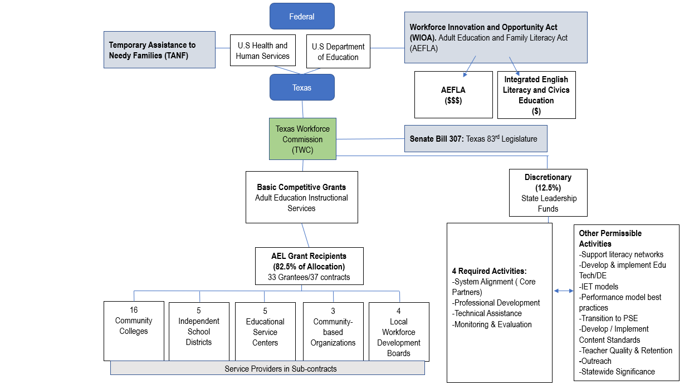
Chart

Slide 8
How Do You Fund Providers?
Must Be Competitive Statewide Procurement
  Mostly outlined in federal statute and regulations
  Some state flexibility
States must determine ‘Demonstrated Effectiveness’
Only states can award ‘eligible providers’
All Applicants must respond to ‘13 Considerations’ outlined in federal statute
$80million annual investment
  Applicants must be able to apply for each federal pot of money separately
    Pot 1= AEFLA (231), State GR, and TANF
    Pot 2= Integrated English Literacy and Civics Education (243)

Slide 9
AEL Statewide Competition Underway
Closed January 19, 2024
Grant formations are occurring
New grants executed – July 1, 2024 (5+ yr cycle)
Underwent Significant Changes Based Largely on OCTAE Requirements
Rethink how we conducted our competition and how we will distribute allocations

Slide 10
Program Goals
Programs will provide adults in contracted area with basic education that enables them to effectively:
  become literate and obtain the knowledge and skills necessary for employment and economic self-sufficiency;
  attain a high school equivalency or secondary school diploma;
  participate in postsecondary education and training through concurrent or Co- enrollment in Workforce Training programs including through co- enrollment in Integrated Education and Training (IET) programs; and
  enter or advance in employment including, prepare for unsubsidized employment in in-demand industries and occupations that lead to economic self-sufficiency;

Slide 11
Texas Performance Indicators
Participants Served – State/LBB only
Measurable Skills Gain – Federal only
Employed/Enrolled Q2 After Exit – LBB/Federal
Employed/Enrolled Q2-4 After Exit –LBB/Federal
Credential Attainment –LBB/Federal
Effectiveness in Serving Employers—Retention measure announced June 11, 2024
Disclaimer: Variations in methodology between LBB/Federal
Federal Methodology: OCTAE Memo 17-2, Chg 3 (June 11, 2024)

Slide 12
Program Stats
Students and Staff
Providers and Sites
70,000+ students annually:
  70% Female
  16,000 16-24 y/o
  48,500 24-54 y/o
  73% Hispanic/Latino
  30,000+ Low Income
  17,000+ Long Term Unemployed* (27+ consecutive weeks)
3,500+ Staff (instructional and non-instructional)
  Majority Part Time
  Bachelors Degree Required
  Majority W/out education certs (Elem or Secondary)
  Need more qualified instructors
  * Does not take into consideration work authorization
(PILOT) Two 100% Virtual HSE Providers
  University of Texas—Austin
  Texas Tech University
100+ Providers – Statewide
  Community Colleges
  School Districts
  Workforce Boards
  Education Service Centers
  Non-Profits
800+ Sites –Statewide
  There are some counties that only have virtual or distance education options available –60% of all students participate in DE coursework
Math Assistance Call Center –Open Daily 7am-10pm CST
Distance Education Call Center—Open Daily 7am-10pm CST

Slide 13
Who Do We Serve?
College Ready
12.9 Grade Level
12.9 Grade Level
High School Equivalency /
Skills Upgrade
With or without a high school diploma
With or without a high school diploma
English as a Second Language
0 Literacy
0 Literacy

Slide 14







AEL Activities/Programs
HSE & Beyond
Corrections
Education
CAREER Pathways
English
Language Acquisition
Employer
Engagement
Core Services
Basic Skills Instruction
Digital Literacy
Family Literacy
Workforce Preparation activities
English Language and Civics Education
Services to Skilled Immigrants
IET for ELLS
Workplace Literacy
Incumbent Worker Training
High School Equivalency
Transition to PSE
Targeted remediation (Math, Reading, Writing)
Corrections Education
Post Release Services/Re-entry
Collaboration with WF Board Services
Integrated Education & Training (IET)
Workforce Preparation

Slide 15
Flexible Instruction
Synchronous and Asynchronous Instructional Options
Hybrid and Flex Learning
Day and Evening Class Options

Slide 16
Important Legislation
SB 307 – 83rd Session (R) – moved program from TEA to TWC
HB 1949 –86th Session (R) –added sections to Texas Labor Code 315.007 with specific measures for awarding of incentive funds and requires Commission to approve grant selection decisions
HB 1525 –87th Session (R) –created the HSE Voucher Program in coordination with TEA. TEA provides funding for our students to receive no cost vouchers for TxCHSE tests.
HB 1602 –88th Session (R)—requires the Commission to give priority in awarding funds to entities that consistently satisfy annual performance requirements comparable to Texas Labor Code 315.007 (incentive funds).

Slide 17
Questions?

Slide 18
State Leadership Activities (12.5% Funding)
Each eligible agency shall use funds for the following adult education and literacy activities to develop or enhance the adult education system of the State.
Required Activities
  One Stop/Workforce System Integration
  Professional Development
  Technical Assistance
  Evaluation and Monitoring
Permissible Activities—Align to Strategic State Objectives/Goals
  State support for literacy centers
  Distance Education/Edu Technology
  Curriculum / Content Standards development and deployment
  IET model development
  Assisting programs with meeting performance indicators
  Integration of English language with occupational skill training
  Improving teacher retention
  Outreach (employers, instructors, students)
  Develop programs for those with learning disabilities or ELL, which can include assessment tools
  Other activities of statewide significance that promote the purpose of Title II

Slide 19
State Leadership Builds Capacity
Many of our state leadership funded initiatives are to develop and enhance our statewide eligible provider network (WIOA Sec. 223)
  Promising Practices
  Innovation
  Expansion of models

Slide 20
Examples of SL Initiatives
Goal 2: Address Demand with Increased Access
SL Initiative | Objective
Employer Engagement: Applicants were required to offer AEL eligible employees services: workplace literacy, workplace literacy with employer-provided training, and incumbent worker training that leads to industry recognized credential | Objective 3: Increase employer, business community, and community-based organization roles in AEL, Action Item 2
Pre-Apprenticeship Bridge Program: grants awarded had to provide remediated instruction to applicants entering building trades related Registered Apprenticeship Programs. Focus on reading and math for specific industry and occupations. | Objective 1: Enhance student service models with immediate and responsive AEL program models, Action Item 1
IET in Corrections: Interagency contract with Windham School District (WSD) to develop and expand IET models for 500 residents and provide re-entry and post-release services | Objective 3: Increase employer, business community, and community-based organization roles in AEL, Action Item 4
Distance Education Professional Development Center: delivers distance & remote learning training, technical assistance, and capacity building services. Includes distance education call center, Distance Learning Technology Institute, and creation of statewide digital literacy content standards. | Objective 4: Increase student access to digital technology, broadband and distance learning applications, Action Item 3 & 4

Slide 21
Recommendations
Advisory Recommendation | Goal | Objective
Employer Collaboration: Talent Pipeline Management/Toolkit for contextualized curriculum;
Employer Collaboration: Employer Connect Center (PD Center); curriculum for workplace literacy classes in key sectors
Employer Collaboration: Expansion of IET models
Partner Collaboration/No Wrong Door Approach: ‘Academy’ for front line staff, cross training
Partner Collaboration/No Wrong Door Approach: Data system alignment
Partner Collaboration/No Wrong Door Approach: Co-location for WFS and AEL
Partner Collaboration/No Wrong Door Approach: PD to support instructors working with young learner
Partner Collaboration/No Wrong Door Approach: Referral process for Corrections Re-entry

Slide 22
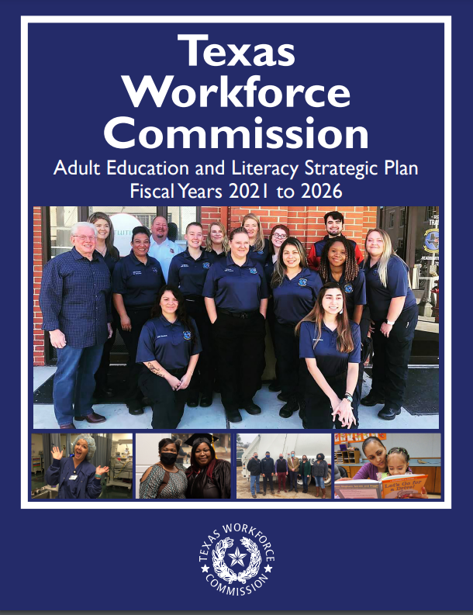

TWC AEL Strategic Plan
TWC AEL Strategic Plan 2021-2026
2024 – Two Year Progress Report due 12/1/24
  June 2024 – Kick off Discussions
  Sept –Draft for Advisory Committee Review
  2022 Progress Report : https://www.twc.texas.gov/sites/default/files/enterprise/docs/ael-strategic-plan-progress-report-2022-twc.pdf
2025 –Will start working on revisions
  March 2025 – Kick off Discussions

Slide 23
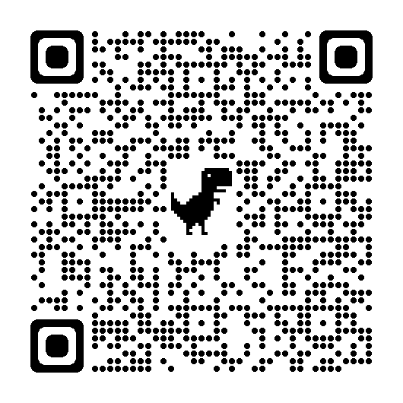
AEL Strategic Plan
Review Current Goals (4) – Keep, Expand, Add, Remove
Review Objectives (17) – Keep, Expand, Add, Remove
https://www.twc.texas.gov/sites/default/files/wf/docs/adult-education-and-literacy-strategic-plan-2021-2026-twc.pdf

Slide 24
Committee Discussion
Putting Recommendations Into Action

Slide 25
Committee Discussion Page 2
Topics
No Wrong Door Approach
Statewide Needs Assessment

Slide 26
Next Meeting
Tentative Date
Wednesday, September 25th, 2024

