Slide 1
Using the Skills Development Fund to Invest in Your Business

Slide 2
Customized Training for Texas Employers
Purpose:
The purpose of the Skills Development Fund is to assist businesses by financing the design and implementation of customized job-training projects.
Goal:
The goal of the Skills Development Fund is to increase the skills level and wages of the Texas workforce.

Slide 3
SDF Grant Details
Single-business project can be up to $500,000​
Cost per trainee target of $2,000​
Customize training to fit business’s needs​
Training for full-time employees​
12-month grant term​​
Equipment costs for training purposes may be allowed for multiple business projects ​

Slide 4
The college or workforce development board is the grant applicant, recipient, and manager that works with the business partner to develop a comprehensive, customized training program (Has contract deliverables with TWC)
Collaborative Partnerships
The business partner stays actively engaged with the college throughout the project
Provides the college with necessary information and documentation in a timely fashion.
Signs a Memorandum of Understanding (MOU) with the college.
Fulfills obligations to its employees and the college throughout training
TWC provides technical assistance throughout the process - Provides subject-matter expertise while building the project
Provides funding for the project
Ensures the project stays true to applicable laws, rules, and parameters

Slide 5
Customized Training
Who do you want to train?
Must be full-time, regular employees
Job titles, wages and dates of hire
Job description on company letterhead for each employee may be requested
PII, including SSN (non-negotiable), full name, mailing address, birth date, and other information relevant to training after training is approved
What training do you want?
An application requires a budget, and a budget requires a course list. We can’t do that without the business input
Training is customizable, or the college can create a new course for your needs
Instructor and delivery method?
Will the college provide the training? Do you have a vendor you want to use? Do you want to train internally?
The college must provide at least 50% of the training

Slide 6
Consider how long you can let each employee train and how it will affect your overall productivity
Obligations & Considerations
You will be required to pay your employees' wages during training
All trainees must be paid at least the 25th percentile prevailing wage based on the workforce board area wages
Reporting requirements We will need personal identifiable information (PII) for reporting purposes.
Work with the college to build the training plan you need
Stay engaged in the process Your buy-in early in the process will help ensure success This may encompass your upper echelons, legal counsel, training staff, HR, supervisors, and trainees.
Work with your teams to get documentation to the college or workforce development board as quickly as possible
We will need job descriptions and wage data Share desired training so we can build the budget

Slide 7
Reporting requirements from the college to TWC depend largely on you Work with the college or workforce board once you have identified trainees
Business Responsibilities
Understand your obligations to the college This will be addressed in the MOU Don’t over-obligate yourselves
Retention rate of trainees You must retain 85% for 60 days after the conclusion of training (individually) Take this into account when you consider who you want to train
Wage rates and raises All incumbent (with the company more than 1 year) trainees must receive an average of 1% raise at the end of the training (average, not individual) New and incumbent trainees must meet prevailing wage determined by your workforce board area

Slide 8
What to consider during Project Development?
Employees must be paid during training
The grant does not cover wages to trainees
Individual training totals are capped at $2,000
85% trainee retention for 60 days after training.
Business must be up-to-date on UI insurance to TWC
Must meet 25th percentile prevailing wage for the area
Average 1% wage increase at the end of training for incumbent trainees
Management job titles (11-1xxx, 11-2xxx, and 11-3xxx SOC codes) not allowed to participate
Application must meet
75% Business/ General Technical
25% Non-Technical

Slide 9
Benefits of the Skills Development Fund
Increased Employee Retention
Since the creation of the Skills Development Fund, nearly 420,000 jobs have been created or upgraded
Additional Recruiting Opportunities
SDF provides an opportunity for your employees to grow within the company, thus creating additional employee buy-in
Build a Partnership with Local Workforce Boards
SDF provides an opportunity for the employer to utilize the services that the local Workforce Board provides such as job fairs, hiring events, employee screenings, etc.

Slide 10
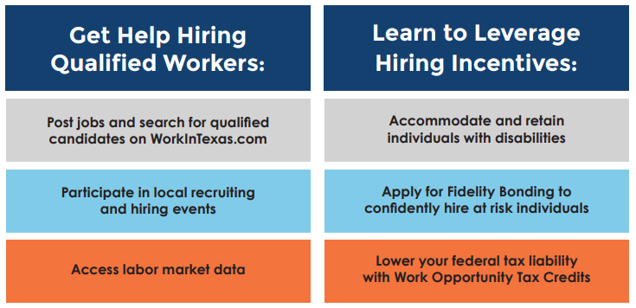
Benefits of Building a Partnership with Local Workforce Boards

Slide 11
Employer Engagement & Community Outreach Department​
Outreach & Employer Initiatives Division​
Texas Workforce Commission​
Texas Workforce Commission ​
Outreach and Employer Initiatives
Skills Development Fund ​

Slide 12
Kristie Caviness
Manager
Employer Engagement and Community Outreach
kristie.caviness@twc.texas.gov

