Slide 1
Gary Job Corps Center
Christopher Roff, Deputy Center Director
Susanne Ritter, Admissions/Placement Director

Slide 2
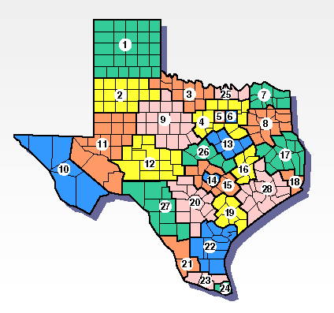
Gary Job Corps Center
Job Corps program has been going strong for 58 years.
We cover 12 WDA’s (Workforce Development Areas)
Our center is located in San Marcos, TX
We have satellite offices throughout our NEAP (National Enrollee Assignment Plan) which house 26 Admissions Counselors and 18 Career Transition Specialists
Largest in the nation
  Our contracted on-board strength is 1471 students
    This includes residential and non-residential students

Slide 3

Job Corps resources and Information Slide
  Federally Funded Program
  100% free to program participants
  Students receive bi-weekly stipends
  Clothing allowance and uniforms provided
  Work based learning opportunities and leisure time employment
  Tools
  Transition funds
  Free meals
  Healthcare including dental and vision
  Mental health support including substance abuse counseling
  Full gym
  Art and Music rooms
  Women’s center
  Theater
  Olympic sized pool
  Recreation trips
  And much, much more……

Slide 4


3 Career Pathways
Health Service
Certified Nurse Assistant
Certified Medical Assistant
  EKG
  Phlebotomy
Medical Billing & Coding (MAIC)
Pharmacy Tech
Human Service
Office Administration
Security
Corrections
Advanced Transportation Communication Union

Slide 5
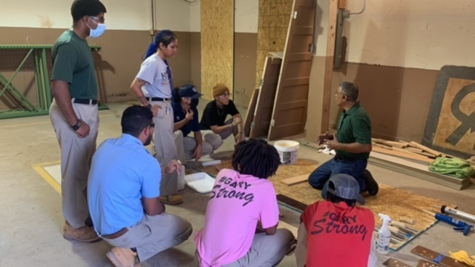
Construction & Manufacturing Pathway
Machinist
Material Handling
Carpentry
Building Construction Technology
Flooring Pre-Apprentice
HVAC
Welding
Electrical
Advanced Overhead Linesman
Plastering
Advanced Cement
National Flooring Contractors Association

Slide 6
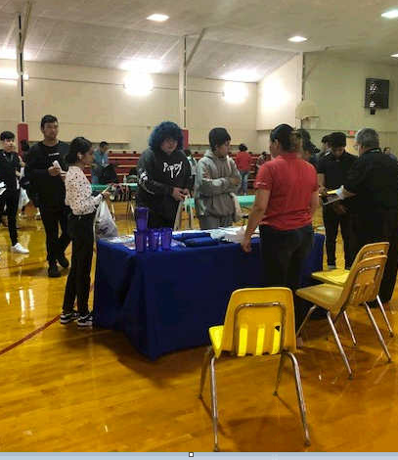
Mutual benefits
Soft skills taught from day one
All services are individualized, no one size fits all
Diverse population
Industry recognized credentials
Fully accredited
Use MyPACE to determine career plan
Stackable credentials
Continued support beyond separation.
Our goals align with other WIOA funding recipients. (placement, PEIMS)

Slide 7


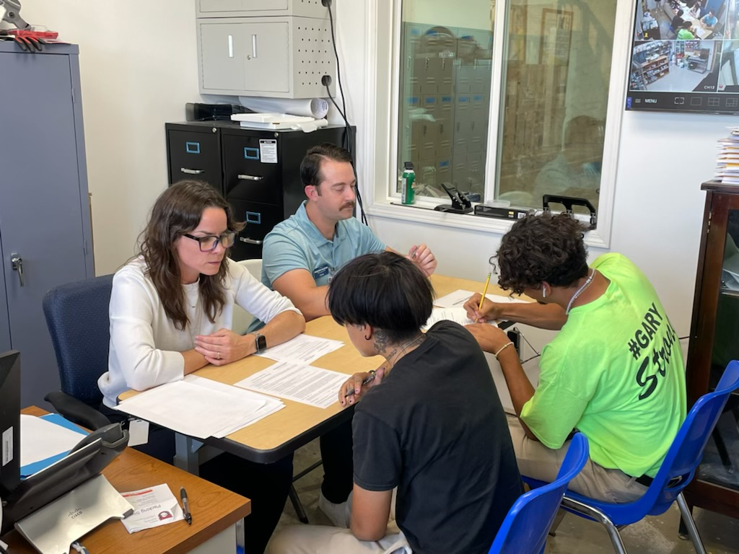
Opportunities for Community Engagement
Outreach
Internships
Volunteer opportunities
Presentations to our students
Partner employers
Dual Enrollment
Resource sharing (facilities, leads)
Feedback

Slide 8

Connect with Job Corps on Social Media
Facebook: Job Corps
Instagram: DOLJobCorps
Twitter: Job Corps (@DOLjobCorps)
LinkedIn: Job Corps

Slide 9

Any questions?
Thank you for your time
We look forward to building a strong partnership with you.

